Slide 1


Angular Service Worker-PWA
AMITHA MARY BENNY(245166)
ANIRUDH GOPALAKRISHNAN (245099)

Slide 2
What is service worker?
Angular Service Worker is a powerful feature that brings offline capabilities, faster loading, and improved user experience to Angular applications.
With Service Worker, you can cache static assets, such as HTML, CSS, and JavaScript files, as well as API responses, enabling your app to load quickly and function independently of the network.
It enhances your Angular app by providing offline support, background synchronization, and the ability to create Progressive Web Apps (PWAs).

Slide 3
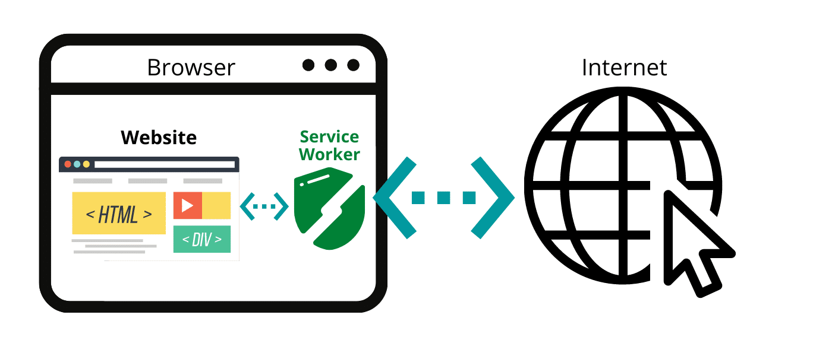
Service Worker
By incorporating Angular Service Worker, will be able to deliver more reliable and engaging experience to the users, regardless of their network conditions.
Service workers act as a proxy between the application and the network, intercepting network requests and enabling the application to respond to them.

Slide 4

What is PWA?
In Angular, a Service Worker PWA (Progressive Web App) refers to the combination of a service worker and the concept of PWA.
PWA is a web application that leverages modern web technologies to provide a more app-like experience to users.
PWAs can be installed on a user's device, have an icon on the home screen, and can work offline.

Slide 5
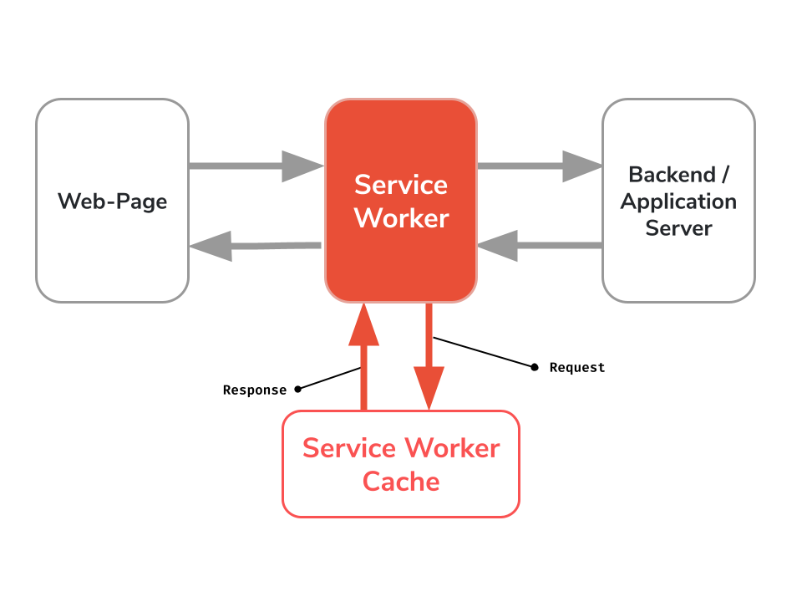
Architecture

Slide 6
Working
Central point of a PWA is a so-called Service Worker, which acts as a kind of proxy between the frontend and the backend.
With every request, this component checks whether
you are online and
new version of the page is available in the backend.
If you are offline or if there is no new version available, the service worker delivers the page as well as JavaScript, CSS and other web resources from the cache and the effective data from a browser-internal IndexDB.

Slide 7
Service Worker PWA in Angular
Install the Angular Service Worker package
ng add @angular/pwa
Configure the service worker in the Angular application by modifying the ngsw-config.json file. This file specifies the static assets to cache, strategies for handling requests, and other options.

Slide 8
Service Worker PWA in Angular
Register the service worker in the Angular application by adding the ServiceWorkerModule to the AppModule imports and calling the ServiceWorkerModule.register() method.
This allows users to access your application even when they are offline or have a weak network connection, making it more reliable and providing a better user experience.

Slide 9
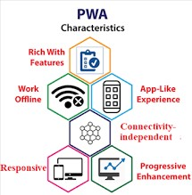
Advantages
Offline Support
Improved Performance
Background Updates
Push Notifications
SEO-Friendly
Cross-platform Compatibility

Slide 10
Disadvantages
Increased Complexity
Limited Browser Support
Cache Management
Increased Development and Maintenance Effort
Limited Control Over Caching
User Awareness and Adoption

Slide 11
THANK YOU
Amitha Mary Benny (amithamary.benny@ust.com)
Anirudh Gopalakrishnan(anirudh.g@ust.com)

